Slide 1

Real-Time Notification System
By S.Harshitha

Slide 2
Problem Statement
Traditional web applications depend on manual page refresh or repeated server polling to receive updates. This causes delays, increases server load, and provides a poor user experience.
Proposed Solution:
Develop a Real-Time Notification System using Spring Boot and WebSocket technology that allows users to receive instant notifications whenever a new message is generated

Slide 3
Methodology
System Workflow
User enters a notification message.
Frontend sends request to Spring Boot backend.
Notification is stored in MySQL database.
WebSocket broadcasts notification.
Connected clients receive updates instantly.
Technologies Used
Layer Technology
Frontend HTML, CSS, JavaScript
Backend Spring Boot
Database MySQL
Real-Time Communication WebSocket
Development Tool VS Code

Slide 4
Results/outcomes
✓ Real-time notifications delivered
✓ Notifications stored in database
✓ Multiple users receive updates
✓ No page refresh required
✓ Improved communication speed

Slide 5
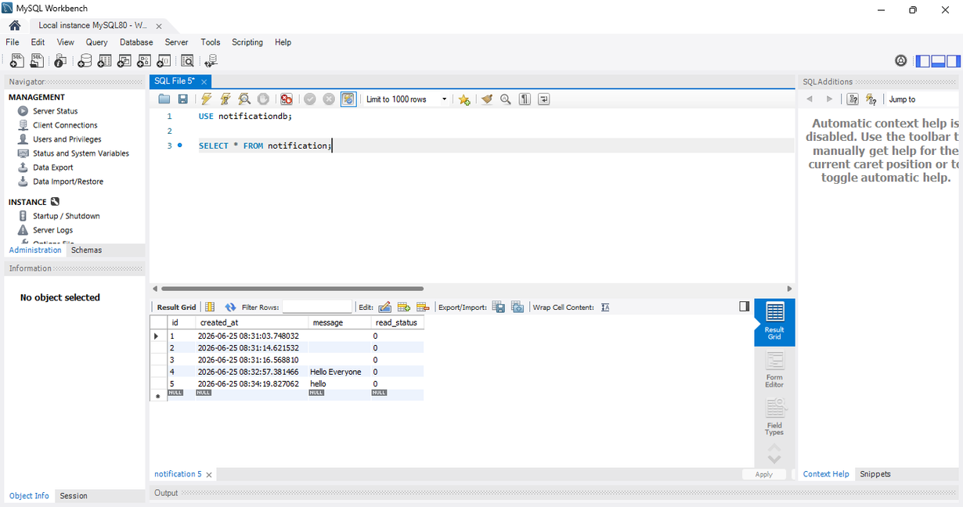
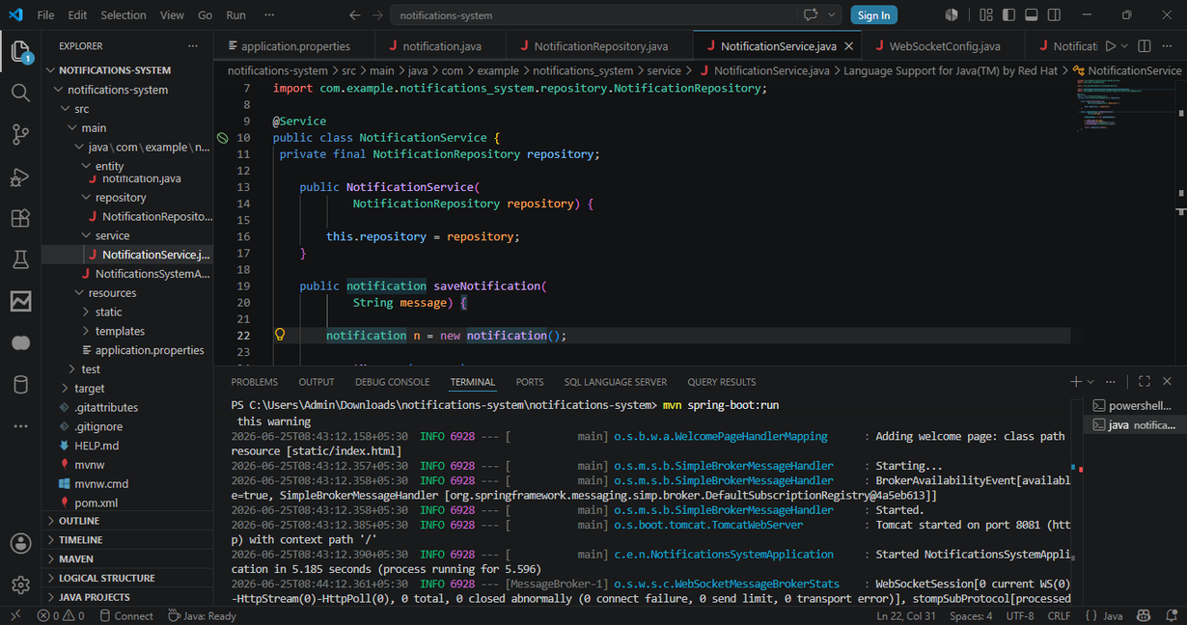
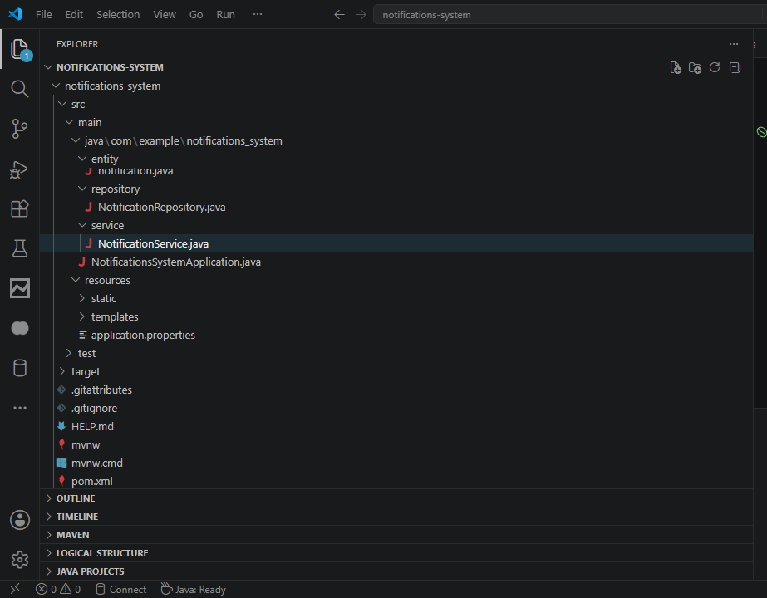
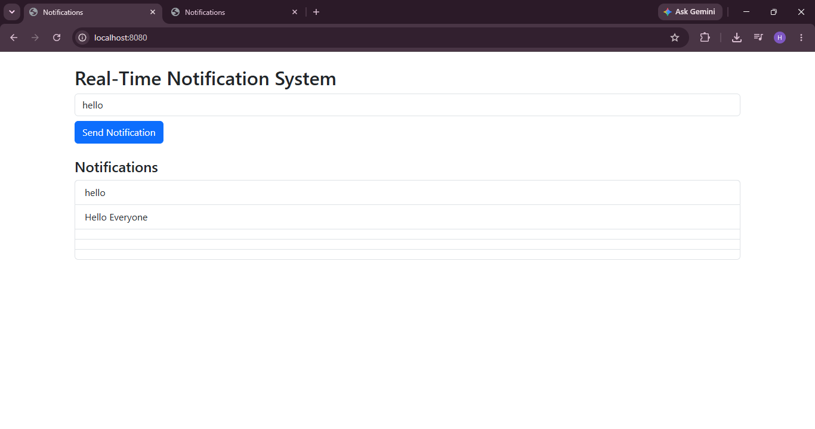

Slide 6

Conclusion
The Real-Time Notification System was successfully developed using Spring Boot, WebSocket, MySQL,HTML, CSS, and JavaScript.
The system provides instant notification delivery and improves
user experience through real-time communication.

